Slide 1
Marketing Plan

Slide 2
Company Name Name: Ovaro

Slide 3
-OVARO is a handmade macramé brand that offers elegant, handcrafted decor and accessories. The brand blends traditional knotting techniques with modern boho aesthetics to create warm, personalized, and artistic pieces. -Products : Wall hangings, curtains, swings, and plant holders made of macramé and handcrafted macramé handbags -Category : Handmade Home Decor & Accessories
Business Summary

Slide 4
Marketing Objective
Goal 1: Improve Instagram Presence Goal 2: Increase Engagement and Sales via Facebook

Slide 5
SWOT Analysis
Strengths | Weaknesses
Products appeal to emotional and lifestyle-driven buyers ( brides, home decor lovers) Ability to customize products for individual customer needs. Mass Production | Low advertising budget or limited paid campaign budget Lack of a dedicated video editor Instagram page is newly created, with low follower count and limited engagement
Opportunities | Threats
Collaborations with influencers or interior designers Seasonal product launches (Ramadan, weddings, summer collections) Growing demand for natural, boho, and handmade home decor | High Price of raw materials Trend shifts in home decor or fashion

Slide 6
Competitor Analysis
Social Media | Competitor 1 | Competitor 2
link | https://www.instagram.com/macrame_w_crochet/ | https://www.instagram.com/macrame_market/
NO of like or follower | 28.8K | 53.9K
page created
visual identity | good | Above average
publishing rate | 2 posts /week | 1 post / month
Engagement Rate | 85 like / post | 32 like / post
major product or service | Macrames | Swings
Average price

Slide 7
Audience
Gender : Females
Age: 19 - 45
Location: Cairo
interest :Interior design and home organization ,Pinterest boards and Instagram decor pages and Sustainable and handmade products

Slide 8
Marketing STP
Positioning | Targeting | Segmentation
OVARO creates handcrafted macramé decor that brings natural beauty and cozy elegance into modern homes. | Home decor lovers and gift buyers who value authenticity, aesthetics, and artisan quality. | Demographic: Women aged 25–45, middle to upper-middle income. Geographic: Urban areas (mainly Egypt), with online reach. Psychographic: Interested in handmade decor, boho style, and sustainable living. Behavioral: Buys for home styling, gifting, and seasonal updates.
OVARO handbags are handcrafted statement pieces—blending natural materials, artistic design, and everyday functionality for women who value beauty with purpose. | Young women and professionals who want fashion pieces that are handcrafted, elegant, and sustainable. | Demographic: Women aged 20–40, fashion-conscious, mid to upper-income. Geographic: Urban areas, local and regional (with potential for international via online sales). Psychographic: Values unique, artisanal fashion; follows slow fashion and sustainable trends. Behavioral: Looks for stylish, functional, and eco-friendly accessories; shops for self-expression or gifting.

Slide 9
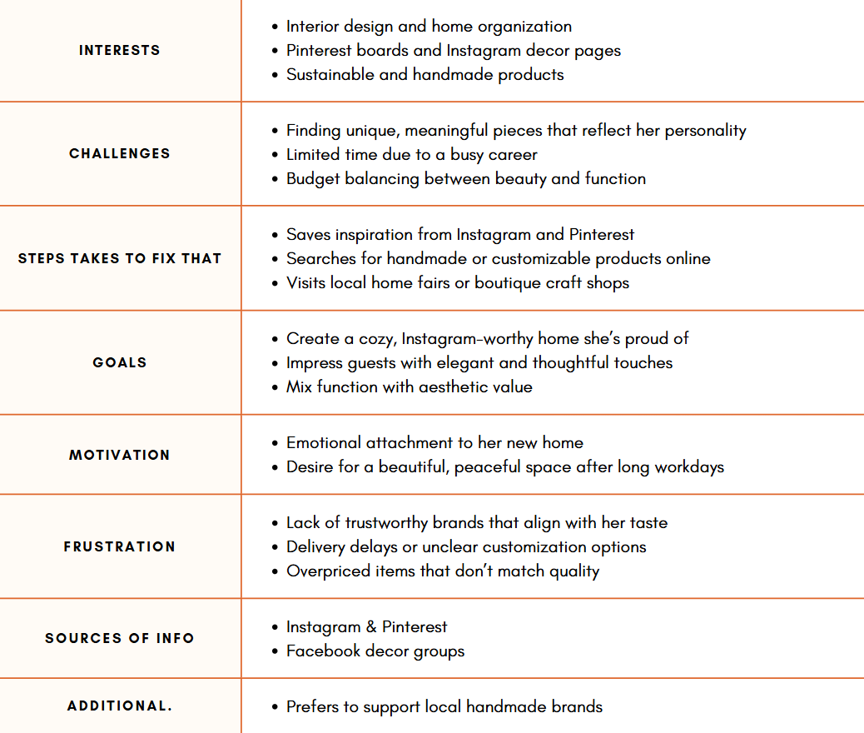
Buyer Persona
Buyer Persona 1

Slide 10
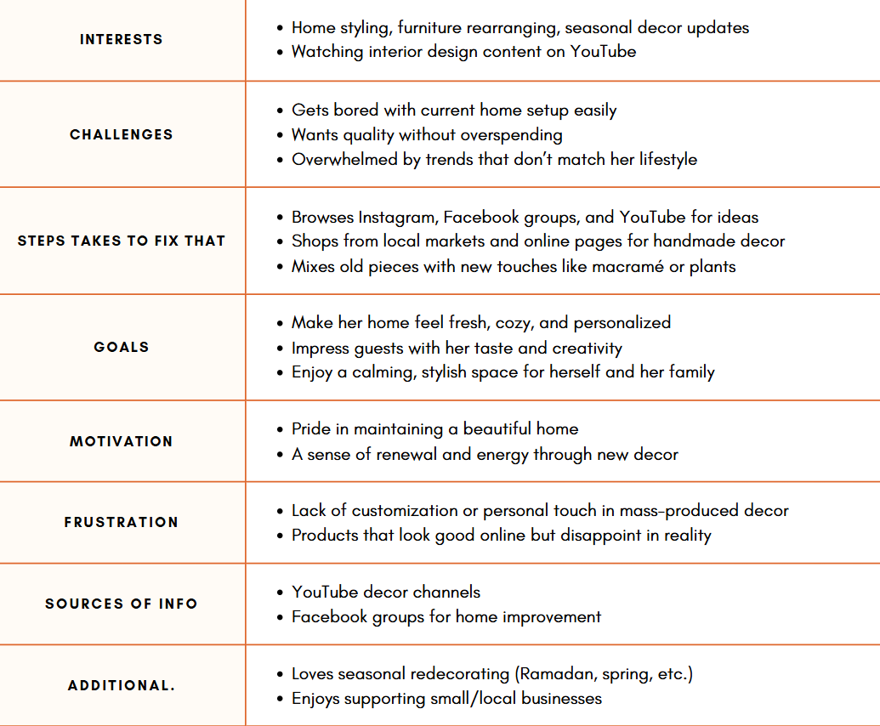
Buyer Persona
Buyer Persona 2

Slide 11
Social Media Channels
Channel | Posts Numbers | Post Type
Instagram | 6 | Product Showcase
Facebook | 32 | Product showcase

Slide 12
1- Reels: Styling ideas – Before/After – How to install or hang the product. Stories: Customer feedback – Work-in-progress – Behind the scenes. 2- Launch Campaign “Your Home’s Beauty, Made by Hand” “Unbox the Boho” “From Thread to Art” 3- Repurpose Instagram content with slight adjustments. Engage in Facebook Groups related to: home decor, apartment setup, handmade crafts.
Action Plan

Slide 13
Thanks

